Slide 1

5. Calculation of lightning
electromagnetic fields
1
Notes:
1

Slide 2
Course Sections | Number of Lectures | HW Due (Canvas) | Test (Honor-lock) | Section in Course Packet | Chapter/Sections in Text (FOL)
5. Calculation of lightning electromagnetic fields | 4 | HW6 04/14 | T6 04/16 | 5 | 5, App. 3
6. Modeling of lightning processes | 3 |  |  | - | 6
7. Measurement of lightning electric and magnetic fields | 2 |  |  | - | 7
8. Lightning locating systems and lightning protection | 2 | - | - | - | 8,9
Review | 1 |  |  | 1-9 | 1-9, App. 1-4
Final Exam (via Honorlock) | - | - | Apr. 28 (W) 12:30-2:30 p.m. | 1-9 | 1-9, App. 1-4

Slide 3
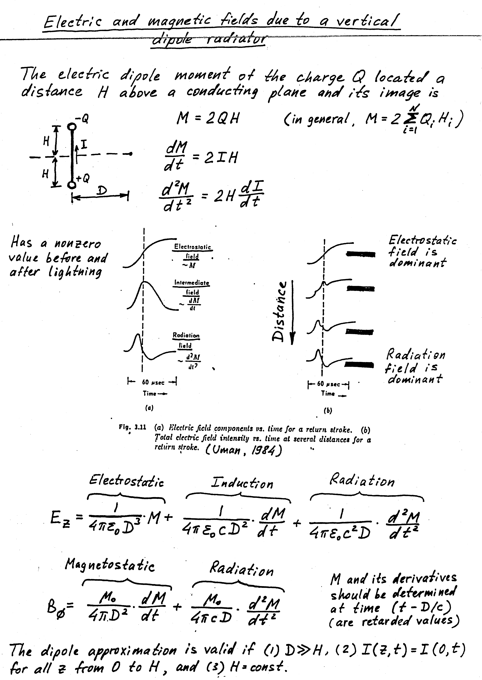
Electric and magnetic fields based on the dipole approximation
The electric dipole moment M of charge Q and its image
(1) D >> H (R = D)
(2) I(z’,t) = I(0,t)
(3) H = const
(very distant Hertzian dipole,
2H << λ, but no restriction on frequency content)
E_{es} ~ Q, 1/D³
E_{i} ~ I, 1/D²
E_{r} ~ dI/dt, 1/D
E = E_{es} + E_{i} + E_{r}
B = B_{i} + B_{r}
E_{z}/B_{φ} = c
~Q
~I
~dI/dt

Slide 4
Exact field equations for a vertical channel and
ground-surface field point
sinθ = r/R
(electrostatic)
(induction)
(radiation)
(induction)
(radiation)
The upper integration limit H(t) (called radiating channel length) can be found from the equation below, where v_{f} is the RS front propagation speed:

Slide 5
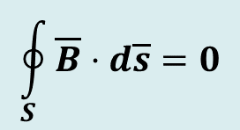

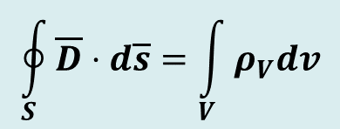
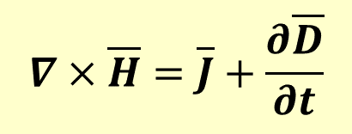
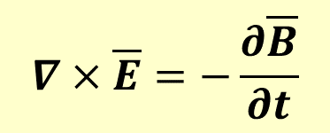
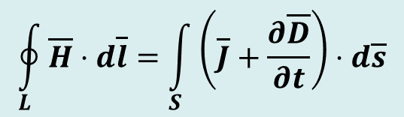

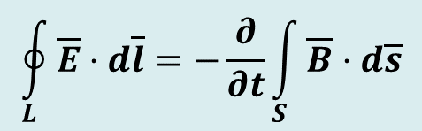
Maxwell’s Equations (relate fields to their sources)
Differential form Integral form Remarks
$$\oint_{S}{\overline{D}}⋅d\overline{s}=\int_{V}{ρ_{V}dv}$$
Gauss’ Law
1
$$∇⋅\overline{D}=ρ_{V}$$
Nonexistence
of isolated magnetic
charge
$$∇⋅\overline{B}=0$$
$$\oint_{S}{\overline{B}}⋅d\overline{s}=0$$
2
$$∇×\overline{E}=−\frac{∂\overline{B}}{∂t}$$
$$\oint_{L}{\overline{E}⋅d\overline{l}}=−\frac{∂}{∂t}\int_{S}{\overline{B}⋅d\overline{s}}$$
Faraday’s Law
3
$$∇×\overline{H}=\overline{J}+\frac{∂\overline{D}}{∂t}$$
$$\oint_{L}{\overline{H}⋅d\overline{l}}=\int_{S}{\left(\overline{J}+\frac{∂\overline{D}}{∂t}\right)}⋅d\overline{s}$$
Ampere’s
Law
4
In 1 and 2, S is a closed surface enclosing the volume V
In 2 and 3, L is a closed path that bounds the surface S

Slide 6
Electric and magnetic fields based on the dipole approximation
The electric dipole moment M of charge Q and its image
(1) D >> H (R = D)
(2) I(z’,t) = I(0,t)
(3) H = const
(very distant Hertzian dipole,
2H << λ, but no restriction on frequency content)
E_{es} ~ Q, 1/D³
E_{i} ~ I, 1/D²
E_{r} ~ dI/dt, 1/D
E = E_{es} + E_{i} + E_{r}
B = B_{i} + B_{r}
E_{z}/B_{φ} = c
~Q
~I
~dI/dt

Slide 7
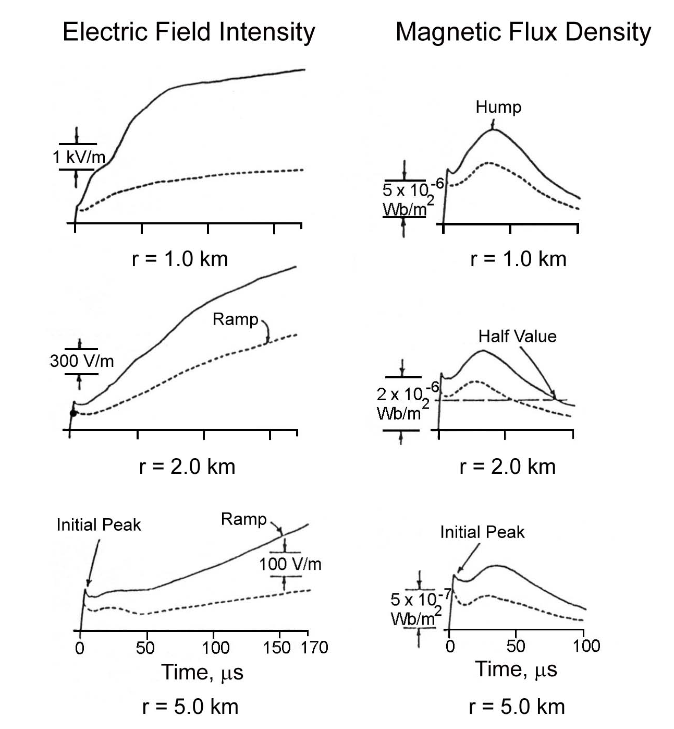
Return-Stroke Fields: Variation with Distance
Electric Field Intensity
Magnetic Flux Density
Fig. 4.32 of the textbook (FOL)
Typical vertical electric field intensity (left column) and azimuthal magnetic flux density (right column) waveforms for first (solid line) and subsequent (dashed line) return strokes at distances of 1, 2 and 5 km. Adapted from Lin et al. (1979). [CATALOG OF TYPICAL RETURN-STROKE FIELD WAVEFORMS]

Slide 8
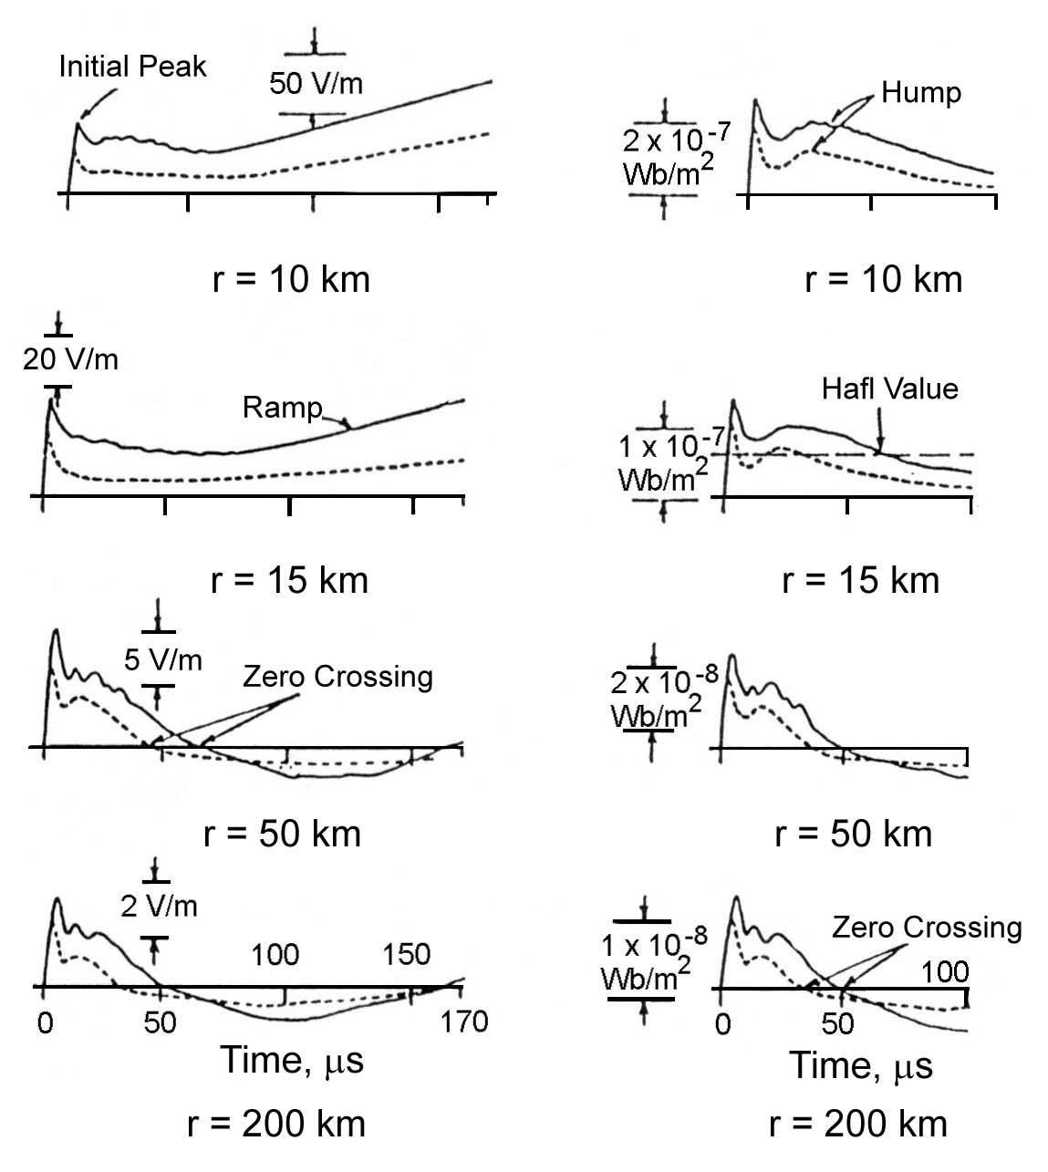
Return-Stroke Fields: Variation with Distance
Electric Field Intensity
Magnetic Flux Density
Typical vertical electric field intensity (left column) and azimuthal magnetic flux density (right column) waveforms for first (solid line) and subsequent (dashed line) return strokes at distances of 10, 15, 50, and 200 km. Adapted from Lin et al. (1979).

Slide 9
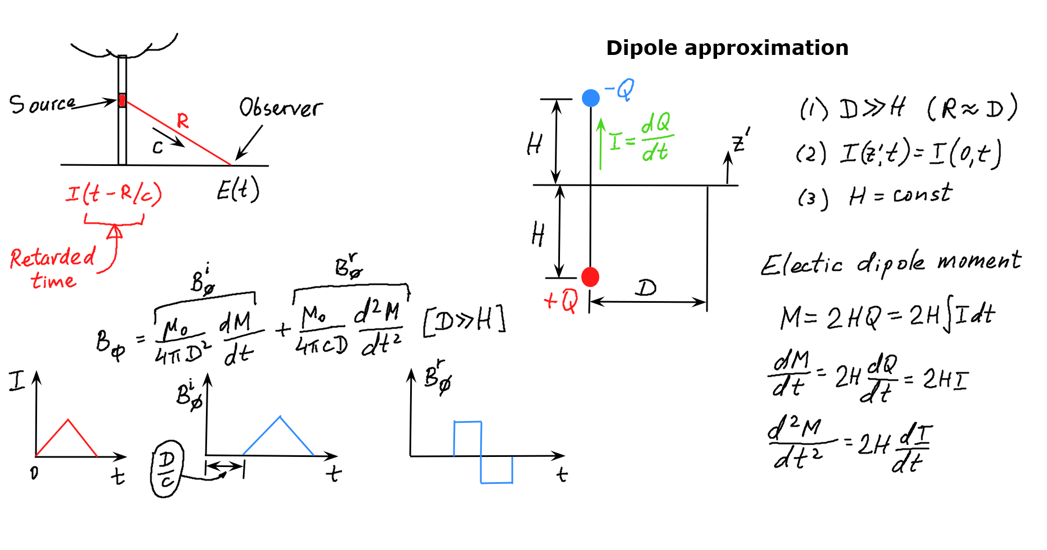

Slide 10
Expressions for fields in terms of potentials
where
is the electric field intensity,
is the magnetic flux density,
is the magnetic vector potential, and
ϕ is the electric scalar potential.

Slide 11
Expressions for fields in terms of potentials
(Eqns. 2 and 3 are used to relate fields to potentials and Eqns. 1 and 4 to relate potentials to sources)
For a vertical cylinder of length dz’, Jdv’ = Idz’ and no integration is needed in (5.4).

Slide 12
Expressions for fields in terms of potentials

Slide 13
Will need to take the curl, the gradient, and the divergence
ρ = r
For a vertical current element Idz’, only A_{z} is nonzero, and there is no φ variation (cylindrical symmetry).

Slide 14
Conversion of spatial derivatives to time derivatives
The spatial derivative
can be converted to the time derivative
Thus,
R = (r² + z²) ^{1/2}

Slide 15
Four configurations to be considered:
#1
#2
#4
#3

Slide 16
Course Sections | Number of Lectures | HW Due (Canvas) | Test (Honor-lock) | Section in Course Packet | Chapter/Sections in Text (FOL)
5. Calculation of lightning electromagnetic fields | 4 | HW6 04/14 | T6 04/16 | 5 | 5, App. 3
6. Modeling of lightning processes | 3 |  |  | - | 6
7. Measurement of lightning electric and magnetic fields | 2 |  |  | - | 7
8. Lightning locating systems and lightning protection | 2 | - | - | - | 8,9
Review | 1 |  |  | 1-9 | 1-9, App. 1-4
Final Exam (via Honorlock) | - | - | Apr. 28 (W) 12:30-2:30 p.m. | 1-9 | 1-9, App. 1-4

Slide 17
Configuration 1
Differential current element at z'=0 in free space;
Field point P at z>0
Noting that r/R = sin(180º – θ) = sinθ, we can also write
(radiation)
(magnetostatic)

Slide 18

Lorentz condition:
The electric field intensity expression has three terms and is given by:
$d\overline{E}=−∇ϕ−\frac{∂\overline{A}}{∂t}$= ${−∇ϕ}_{r}+ {(−∇ϕ}_{z}−\frac{∂\overline{A}}{∂t})$
$$d\overline{E}={dE}_{r}{\overline{a}}_{r }+ {dE}_{z}{\overline{a}}_{z }$$

Slide 19

The two components of
can be expressed as follows (z’ = 0):
$$d\overline{E}={dE}_{r}{\overline{a}}_{r }+ {dE}_{z}{\overline{a}}_{z }$$
(electrostatic)
(induction)
(radiation)

Slide 20
Four configurations to be considered:
#1
#2
#4
#3

Slide 21
Configuration 2
Elevated differential current element (z'>0) and its image
Field point P at z>0
Differential current element elevated to height z’>0
Lower half-space (z<0 – perfectly conducting ground)
Using the Image Theory
Field point P at z height
The vectorial sum of field contributions from the real and image current elements at field point P (z>0) is identical to the field at point P in the original configuration (a single current element above the ground plane)
Real: z => (z – z’)
Image: z => (z + z’)

Slide 22






In order to make the equations for dE_{z}, dE_{r}, dB_{ϕ} derived for Scenario 1 applicable to the real and image current elements located at z’ and (-z’), respectively, the following changes are to be made:
Scenario 1
I(t - R/c) I(z’, t - R/c)
$$z$$
$$z−z′$$
(electrostatic)
(induction)
(radiation)
Scenario 1
$$z$$
$$z−z′$$
R=$\sqrt{r^{2}+{(z−z′)}^{2}}$
(electrostatic)
(induction)
R_{I}=$\sqrt{r^{2}+{(z+z′)}^{2}}$
Note that for the image z => (z + z’)
(radiation)

Slide 23



Scenario 1
I(t - R/c) I(z’, t - R/c)
R=$\sqrt{r^{2}+{(z−z′)}^{2}}$
(magnetostatic)
(radiation)
$$d\overline{B}=dB_{ϕ}\overline{a}ϕ$$
Equations for dE_{z}, dE_{r}, dB_{ϕ}, (and their counterparts for the image current element – replacing (z-z’) with (z+z’)) from Scenario 2 are the basis for deriving field equations for the case of a field point located at an arbitrary position in space and above perfectly conducting ground
At an elevated field point the electric field will have both E_{z} and E_{r} components due to the inclined distances from the real and image current elements to the field point being different.
R_{I}=$\sqrt{r^{2}+{(z+z′)}^{2}}$

Slide 24
Four configurations to be considered:
#1
#2
#4
#3

Slide 25
Configuration 3
Elevated differential current element above ground and its image;
Field point P on the ground surface (z=0)
When z=0, R=R_{I} and contributions from the real and image sources are equal to each other
The effect of perfectly conducting ground plane on B_{φ} is to double the contribution from the real current element
Similar – the contribution from the real and image current elements to E_{z} component are equal causing the field doubling effect
The contribution from the real and image current elements to E_{r} component are equal in magnitude and opposite in sign – radial component E_{r} = 0 (as required by the BC)

Slide 26
Shown below are equations for the real source in Configuration 2;
for the image source, (z – z’) is to be replaced with (z + z’) everywhere,
including expression for R.
At z = 0 (Configuration 3), (z - z’) is to be replaced with –z’ for the real source and (z + z’) with +z’ for its image and, hence, dE_{r} vanishes and dE_{z} doubles. dBφ also doubles (4π → 2π).

Slide 27
Configuration 3: z = 0, R_{I} = R, no E_{r} component, E_{z} and B_{φ} double (x2)
Configuration 2
(real source only)
z=0, x2
(electrostatic)
(induction)
(radiation)
Applicable to an electrically-short (Hertzian) vertical dipole above perfectly conducting ground and the field point at ground level
After integration over z’ –vertical channel of arbitrary length
Configuration 2
(real source only)
z=0, x2
(magnetostatic)
(radiation)

Slide 28
Integrating the dB_{ϕ}(t) from Scenario 3 over the radiating channel
length H(t) we get:
(magnetostatic)
(radiation)
cylindrical
spherical
Equations for B_{ϕ}(t) and E_{z}(t) from Scenario 4 are exact – for vertical lightning
channel, perfectly conducting ground, and field point on the ground surface.

Slide 29
Field equations
H(t) = v_{f}(t – R(H(t)/c)
v_{f}t
Geometry used in deriving general equations for electric and magnetic fields at point P on ground (assumed to be perfectly conducting) a horizontal distance r from the vertical lightning return‑stroke channel extending upward with speed v_{f}.
Adapted from Thotappillil et al.
(1997).
H(t)

Slide 30
Four configurations to be considered:
#1
#2
#4
#3

Slide 31
Field equations
H(t) = v_{f}(t – R(H(t)/c)
v_{f}t
Geometry used in deriving general equations for electric and magnetic fields at point P on ground (assumed to be perfectly conducting) a horizontal distance r from the vertical lightning return‑stroke channel extending upward with speed v_{f}.
Adapted from Thotappillil et al.
(1997).
H(t)

Slide 32

Configuration 4
Vertical lightning channel above ground; field point on the ground surface (z=0)
Applied to the return-stroke process – current wave propagates from the ground level up along the channel
Integrating the dE_{z}(t) from Scenario 3 over the radiating channel length H(t) we get:
$$\overline{E}\left(r,ϕ, 0,t\right)=E_{z}\left(t\right) {\overline{a}}_{z}$$
(electrostatic)
(induction)
(radiation)
cylindrical
spherical

Slide 33
Exact field equations for a vertical channel and
ground-surface field point
sinθ = r/R
(electrostatic)
(induction)
(radiation)
(induction)
(radiation)
Dipole Approximation:
(1) D >> H (R = r = const)
(2) I(z’,t) = I(0,t) – independent of z’
(3) H(t) = H = const

Slide 35
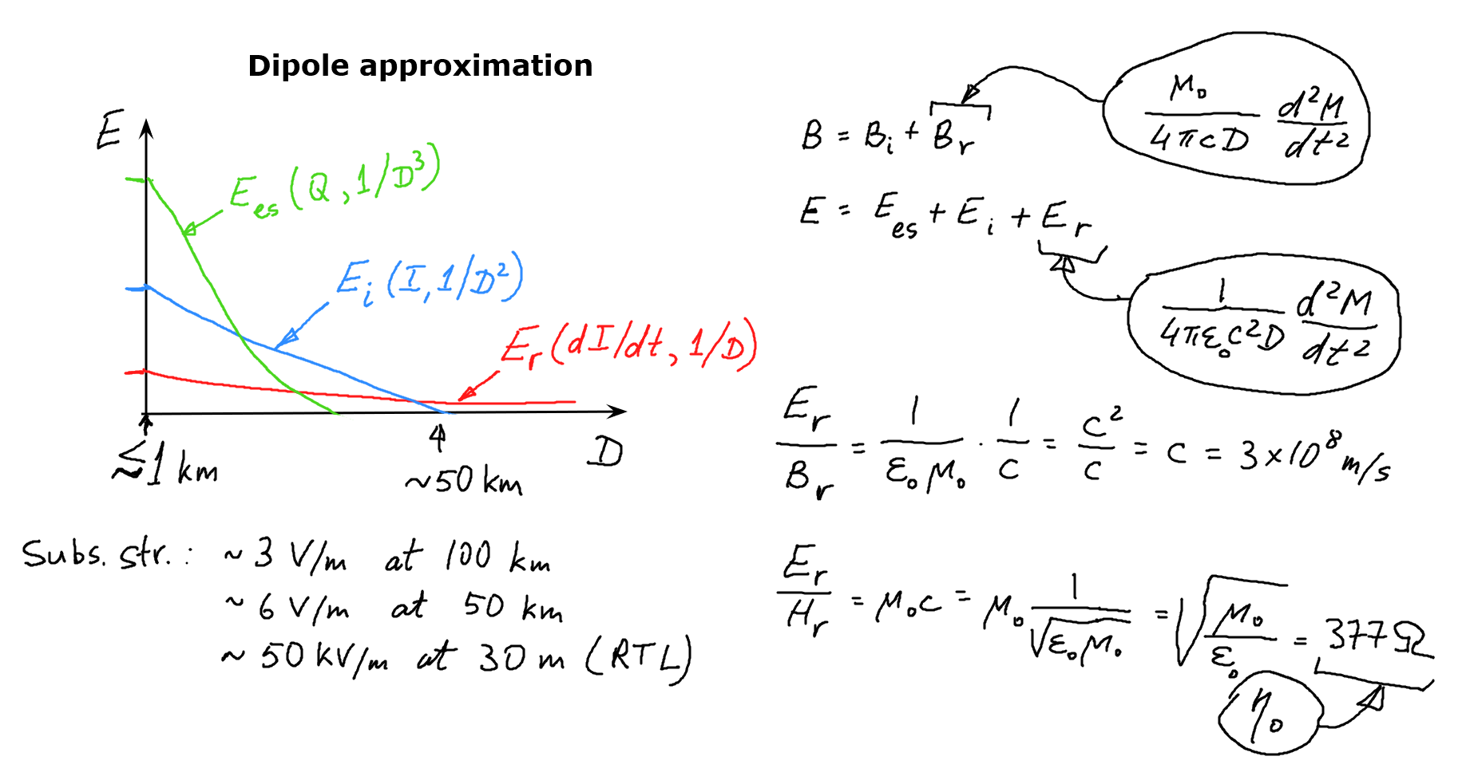

Slide 36
Exact equation for the radiation component of electric field (at far distances approximately equal to the total electric field)
Transmission-line approximation (dI/dt = -v dI/dz’)

Slide 37
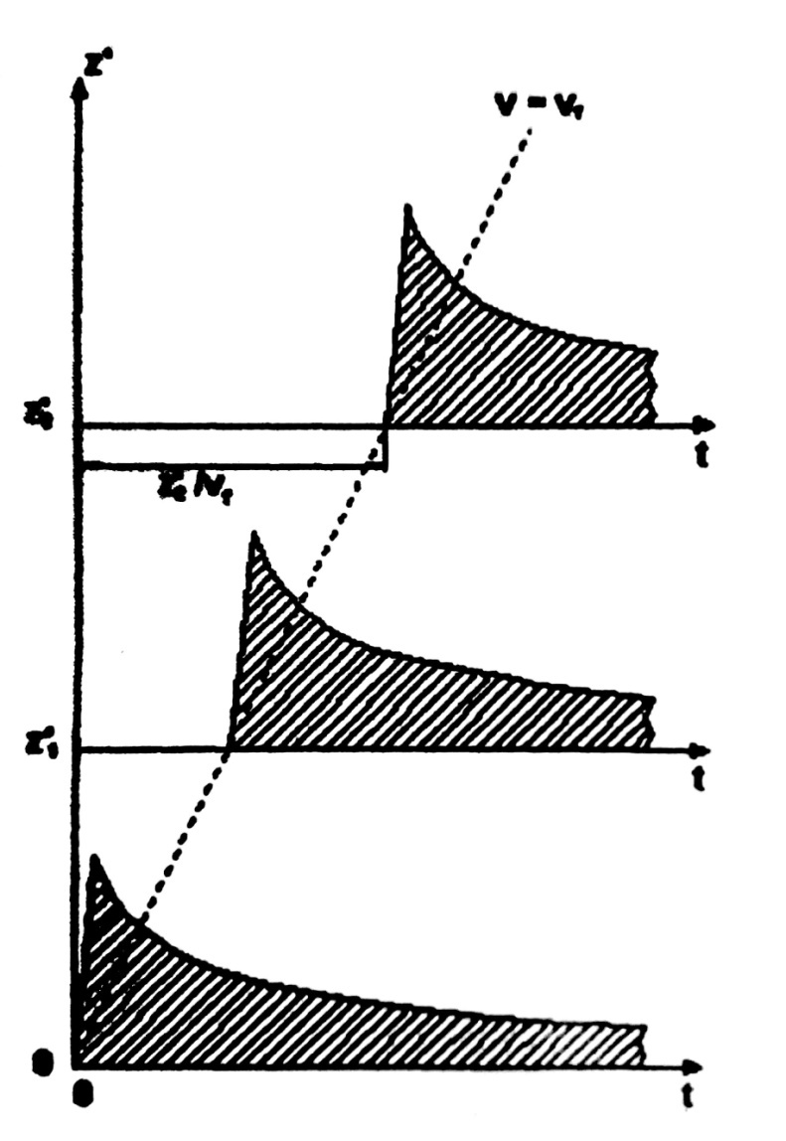
Engineering Models
Transmission Line (TL) Model
I(z’, t) = I(z’=0, t - z’/v_{w})
v_{w} = z’/(z’/v_{w}) = tanα,
where α is the angle between the slanted broken line and the time axis.
In this model, v_{f} = v_{w} = v,
where v_{f} is the upward-propagating return-stroke front speed and v_{w} is the current-wave propagation speed
Subscript “w” is often dropped, so that:
I(z’, t) = I(z’=0, t - z’/ v)
v_{w}
z’₂
z’₂/v_{w}
37
37

Slide 38
Exact equation for the radiation component of electric field (at far distances approximately equal to the total electric field)
TL model to derive the far-field approximation - the radiation component dominant at far distances (r > 50km):
(5.12)
R = r
(5.14)

Slide 39


For the TL model, the time derivative of a current wave (I(t-z’/v)) traveling at constant speed v in the positive direction z’, can be converted to a spatial derivative
$$\frac{∂I(t−z^{′}/v) }{∂\text{t} }=−v\frac{∂I(t−z^{′}/v) }{∂\text{z}\text{′} }$$
For the TL model in terms of retarded time
$$\frac{∂I(0,t−z^{′}/v−r/c) }{∂\text{t} }=−v\frac{∂I(0,t−z^{′}/v−r/c) }{∂\text{z}\text{′} }$$
Normally I(0, 0) = 0, so that the radiation field component is proportional to
the channel base (z’=0) current:
(5.15)

Slide 40
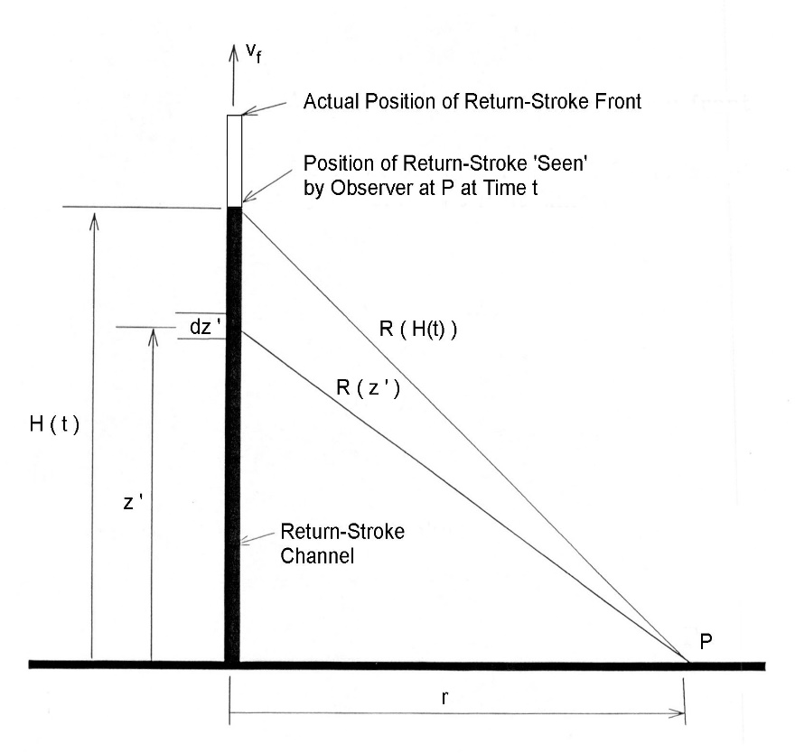
The TL model predicts that, as long as:
(1) the height above ground of the upward-moving return-stroke front is much smaller than the distance r between the observation point on ground and the channel base (R = r),
(2) the return-stroke front propagates at a constant speed,
(3) the return-stroke front has not reached the top of the channel (the first 25-50 us or so), and
(4) the ground conductivity is high enough so that propagation effects are negligible,
the vertical component E_{z}^{rad} of the electric radiation field (and the azimuthal component of the magnetic radiation field) is proportional to the channel-base current I.
40

Slide 41
(spherical TEM wave)
(E_{es} + E_{ind})
(E_{rad})
(E_{es} + E_{ind} + E_{rad})
(H_{ms})
(H_{rad})
(H_{ms} + H_{rad})
Approximate expressions for the electromagnetic fields based on the TL model with an arbitrary return-stroke speed v for near (non-radiation components only) and far (radiation component only) ranges, converging to exact expressions (the sum of all 3 components for E and 2 components for H) as v approaches c.
Adapted from Chen et al. (2015).

Slide 42
Visualization of the TL model
I(z’,t) = I(0,t-z’/v), v = c
Moving spherical wavefront
Transmission Line Theory: a vertical wire
and its image excited by an infinitesimal source,
valid only for v = c (v < c would imply a medium
other than air) and a zero-radius (L = ∞, C = 0)
lightning channel. Spherical TEM field structure
is required for the transmission line theory to be
applicable.
Source
Image
42

Slide 43
Scenario 4
(A3.18)
Note: the lower integration limit in the time integral (A3.18) is zero - the difference between the limits from equation (5.7) is immaterial - because no current in the channel at height z’ is seen at point P during the time interval (0, z’/v_{f} + R(z’)/c)!!!
v_{f}- propagation speed of return stroke front
(5.7)

Slide 44
Scenario 4
(A3.20)
(5.8)
The radiating channel length height H(t) for an upward moving current wave:
For TL model v_{f} = v and at far ranges R ≈ r
(5.13)
(5.9)

Slide 45
For return stroke models with current discontinuity at the moving front , Eqs. 5.7 and 5.8 describe the fields only due to sources below the upward-moving front.
A current discontinuity at the moving front gives rise to an additional term (only a radiation field component) in each Eqs. 5.7 and 5.8:
(5.10)
(5.11)
TL model to derive the far-field approximation - the radiation component dominant at far distances (r>50km):
(5.12)
(5.14)

Slide 46
Comparison of dipole (Lorentz condition) and monopole (continuity equation) techniques
Comparison of electric field components (at ground level) based on dipole
(e.g., Uman, 1987) and monopole (Thomson, 1999) techniques for a differential current element Idz' at height z' above ground.
φ is the scalar potential (different in the two techniques) and Ā is the vector potential;
α=sin⁻¹(z'/R(z')).

Slide 47


The reversal distance for electrostatic and induction electric field components of a short current element (dipole (Lorentz condition) technique)
Figure shows the direction of the radiation component of electric field vector for different combinations of the charge polarity and the direction of its motion (also the direction for all three components when
α < 35.3°). The direction of the electric field vector refers to the initial half cycle in the case of bipolar waveforms.
Adapted from Nag and Rakov (2010).
$$r < \sqrt{2} (z’)$$
$$r > \sqrt{2}(z’)$$
At reversal distance, the electrostatic and induction components are each equal to zero and for smaller α (smaller z’) have the same polarity as the radiation component. So, when integrating over z’ (for the case of vertical grounded channel), contributions from smaller z’ usually dominate those from larger z’, making the polarity of all three components of E-field the same.

Slide 48
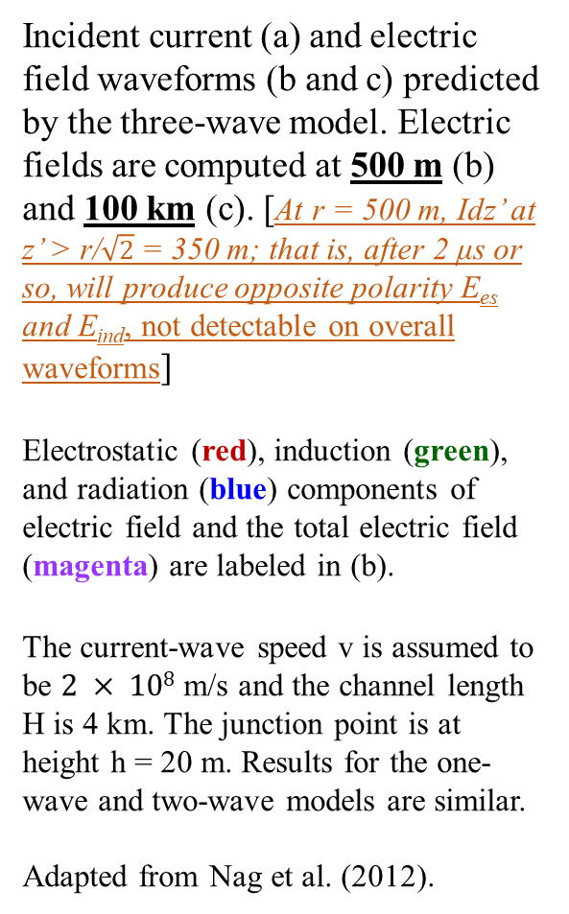
Incident current (a) and electric field waveforms (b and c) predicted by the three-wave model. Electric fields are computed at 500 m (b) and 100 km (c). [At r = 500 m, Idz’ at z’ > r/$\sqrt{2}$= 350 m; that is, after 2 μs or so, will produce opposite polarity E_{es} and E_{ind}, not detectable on overall waveforms]
Electrostatic (red), induction (green), and radiation (blue) components of electric field and the total electric field (magenta) are labeled in (b).
The current-wave speed v is assumed to be $2 × 108$m/s and the channel length H is 4 km. The junction point is at height h = 20 m. Results for the one-wave and two-wave models are similar.
Adapted from Nag et al. (2012).
← Induction
and
Radiation

Slide 49
Compact Intracloud Discharge (CID)
h₁ = 15 km
Δh = h₂ – h₁ = 100 m

Slide 50
↓
↓

